Slide 1
Password Generator
A Secure and User-Friendly Tool for Generating Strong Password
Team Members:
Kishore P
Dhilip R
Sankar K
Summer Internship Project-Full-Stack Development
[Adventure Learning/AIHT]
[24-08-2024]

Slide 2
Slide Title:
Introduction & Objective
1.Introduction:
Password Generator
1. A password generator is a tool that creates strong, random passwords to enhance security. With increasing cyber threats, strong passwords are essential for protecting sensitive information online.
2.This tool addresses the common problem of weak passwords by providing an automated solution for generating secure and unique passwords.
2. Objective:
Project Objective:
The goal of this project is to develop a user-friendly password generator that allows users to create secure passwords tailored to their specific needs. The generator will provide options to customize the length, complexity, and character types, ensuring robust protection against unauthorized access.

Slide 3
Project Overview
1.Key Features:
Customizable Password Criteria:
• Users can select password length, include/ exclude uppercase letters, lowercase letters, numbers,
and special characters.
Real-time Password Generation:
• Passwords are generated instantly as users adjust the criteria.
User-Friendly Interface:
• Simple and intuitive design, making it easy for users to generate passwords with minimal effort.
2. Technology Stack:
Frontend:
• HTML, CSS, JavaScript for the core structure, styling, and logic.
Tools and Libraries:
• Bootstrap
3. Application Workflow:
User Input:
• Users select the criteria for password generation.
Processing:
• JavaScript processes the input and generates a password based on the specified criteria.
Output:
• The generated password is displayed in the user interface.

Slide 4
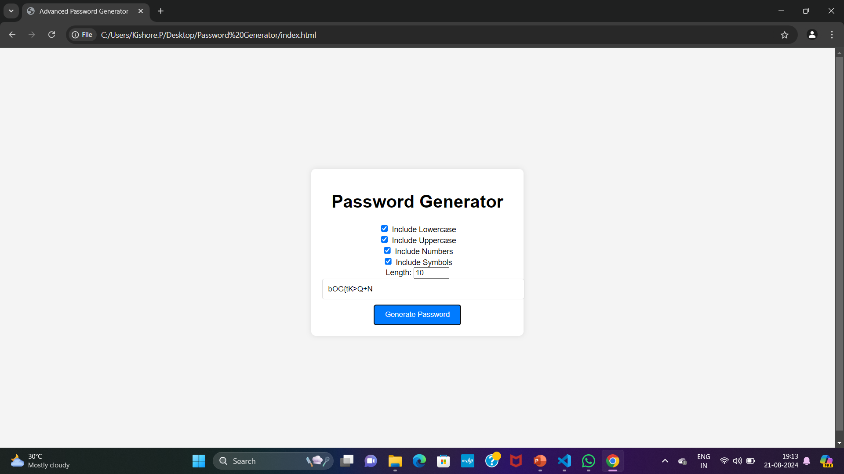
Design and Implementation
User Interface Design:
• Description:
1.The Password Generator is a web application designed to create secure passwords based on user-defined criteria.
2. Users can select options to include lowercase letters, uppercase letters, numbers, and symbols in the generated password. Additionally, they can specify the desired length of the password.

Slide 5
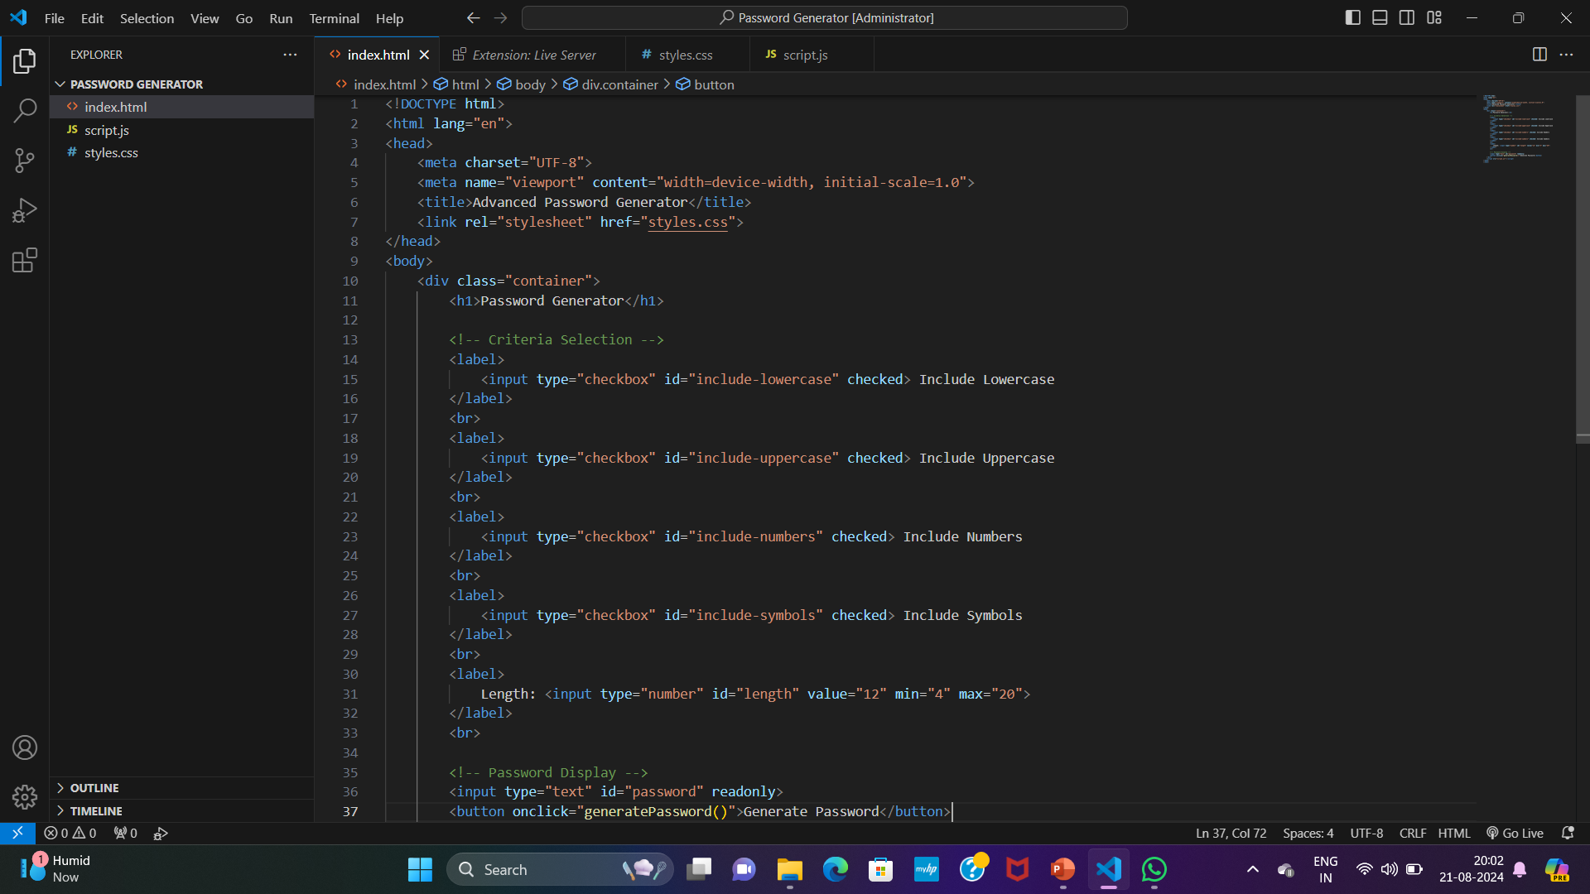
Summary of Code Implementation
HTML Structure
Description:
• The HTML file sets up the structure of the password generator. It includes checkboxes for character types, a number input for password length, and a button to generate the password.
• Visual:

Slide 6
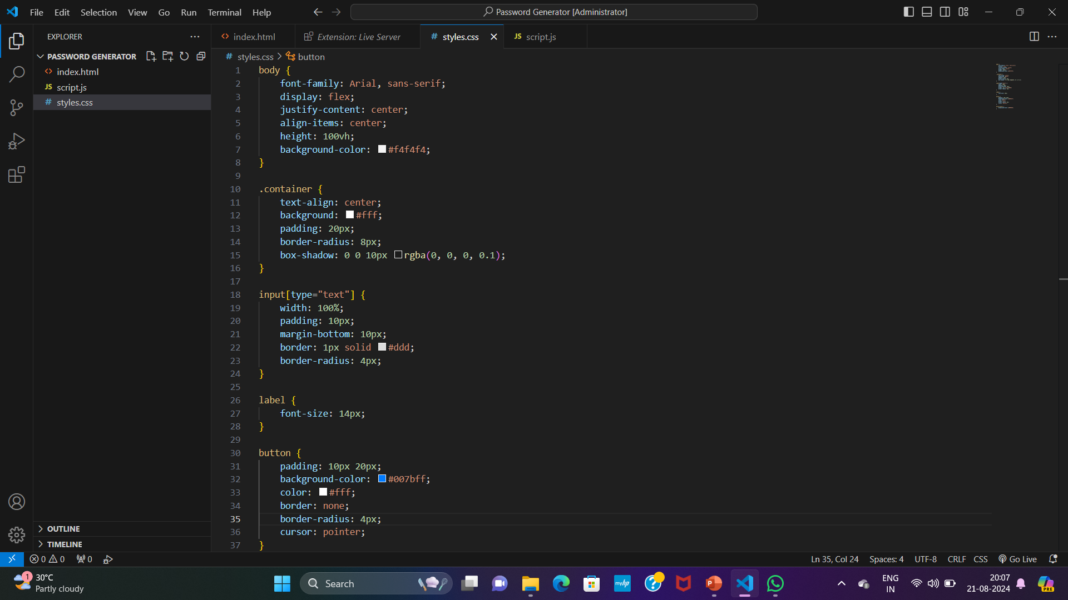
2. CSS Styling
Description:
• The CSS file styles the password generator, providing a clean and user-friendly interface. It includes styles for the container, inputs, labels, and button.
• Visual:

Slide 7
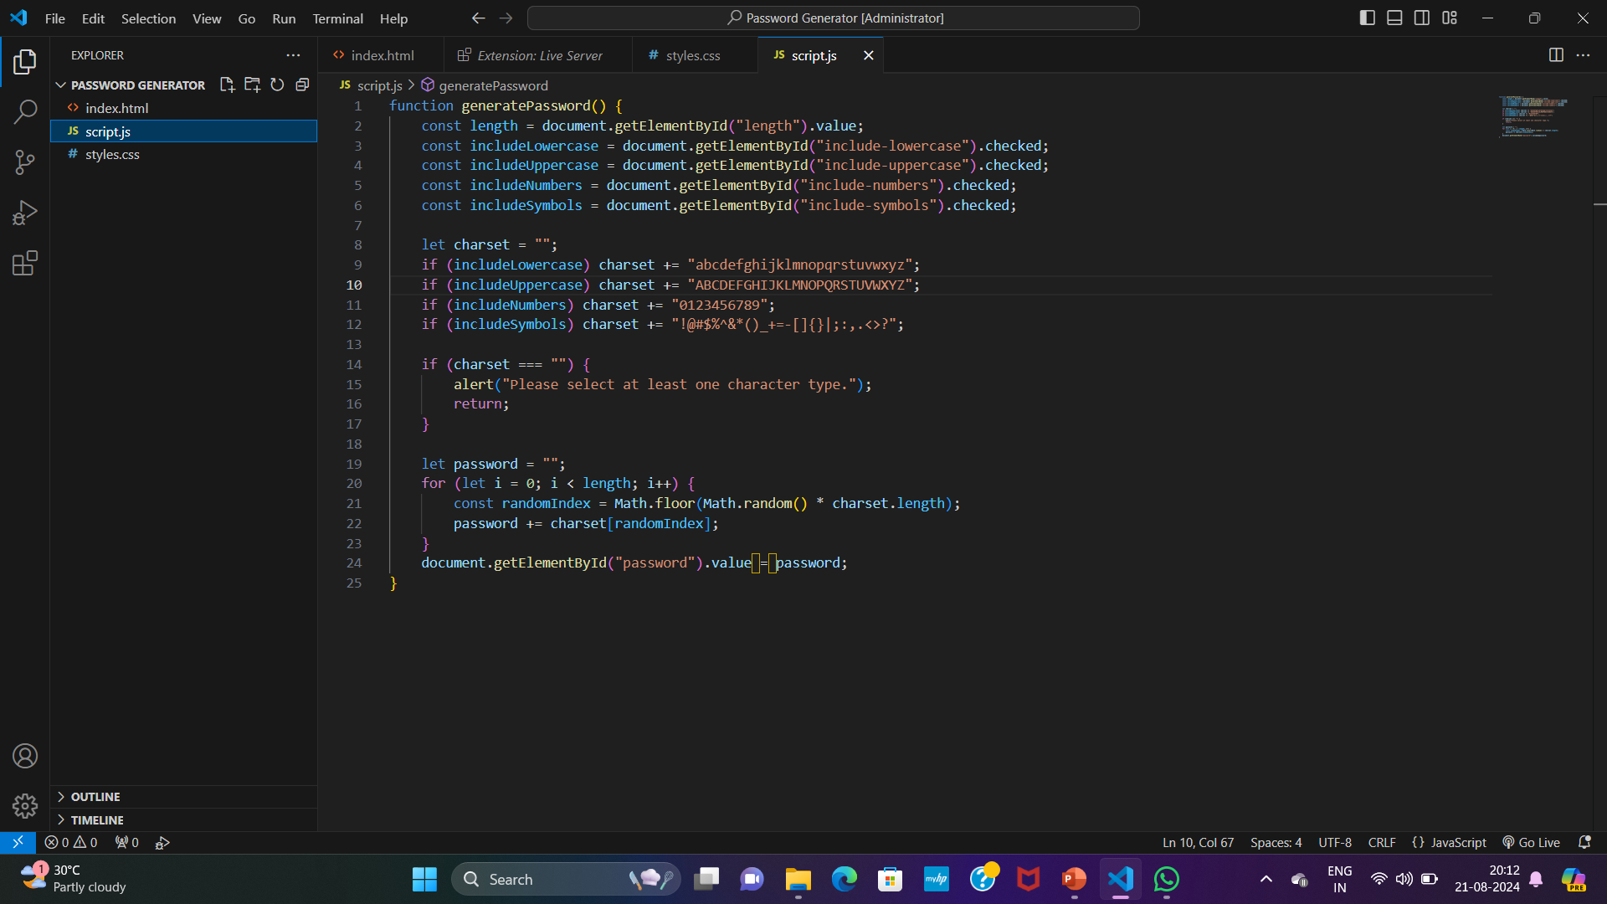
3. JavaScript Functionality
Description:
• The JavaScript code handles the logic for generating passwords based on user-selected criteria. It constructs the password from the selected character sets and updates the display field.
• Visual:

Slide 8
Thank You
Thank You

